Slide 1






PDS
Computer Vision
What Is 5G
https://github.com/siagianp
https://www.youtube.com/@AmelOline/videos
https://github.com/amelcharolinesgn2/IoT_simulator-mqtt-NodeRed
github.com/amelcharolinesgn2/ANJAR

Slide 2
Policy and Strategy
Chief Ministers Committee Report
Received by Tynwald in May 2018
Identified the importance of new technology such as 5G
National Telecoms Strategy
Unanimously approved by Tynwald in October 2018
Supportive of 5G implementation
Programme for Government
Enterprise and opportunity Island

Slide 3
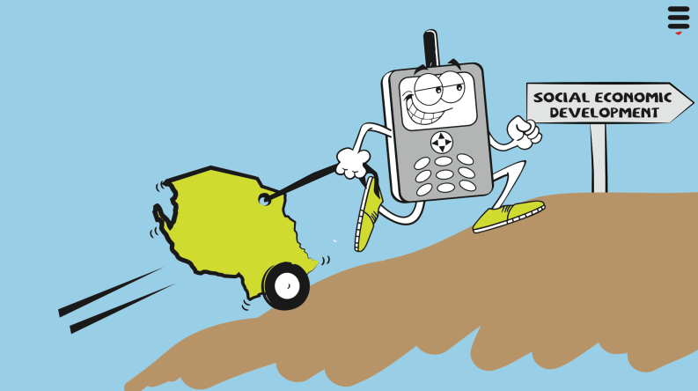
Value of mobile networks to our economic and social development
Through revenue generation, investment and employment
They allow businesses and consumers to increase productivity
As mobile networks are used for an increasingly wide range of functions, their economic and social impact will continue to rise
There are over 88,000 mobile phones on Island increasingly used to communicate, work, play, transact, and to contact the emergency services
Without them we would not attract new business to the island and existing ones (and people) would leave

Slide 4
5G in Context
5G is scheduled to be fully standardised and ratified at the end of 2019 as part of the IMT2020 vision.
It will enable higher download speeds for consumers, massive machine-to-machine (IoT) connections, and provide low latency for critical communications.
It is expected that in the Isle of Man that the key bands for delivery of 5G will be 700MHz and 3.6GHz,
The Commission is currently working on releasing these bands for licensing.

Slide 5
Planning
Enabling infrastructure through Permitted Development
Planning Reform undertake a range of procedural changes which introduce faster processes to allow new smaller telecoms improvements”
Proposed PD easier to understand
speedier allows for development in Conservation Areas subject to Prior Approval
controls development in special areas large masts removed

Slide 6
Health Issues in Perspective

Slide 7
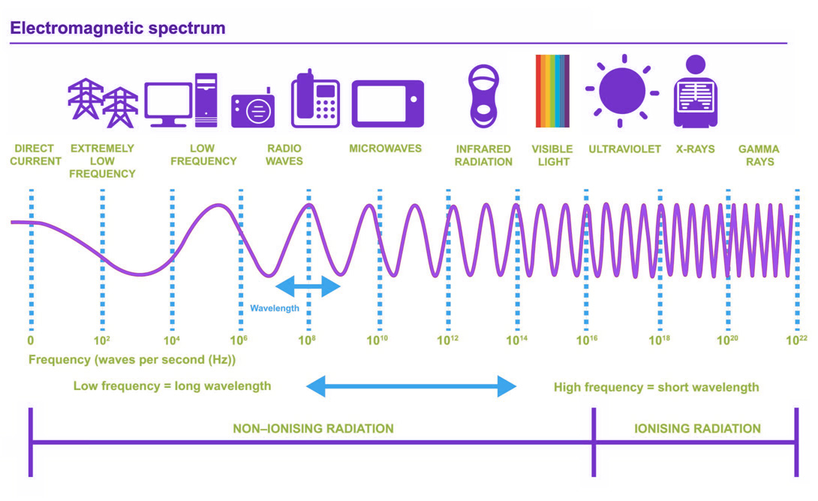
The electromagnetic spectrum

Slide 8
Sources of electromagnetic energy

Slide 9
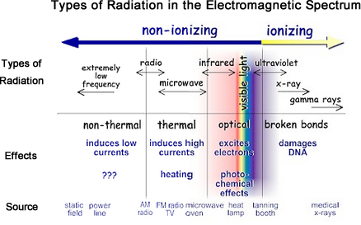
Radiation
rises.

Slide 10
Is 5G different?

Slide 11
What is the evidence for impact on human health?
25,000+ research papers published over last 30 years
WHO International EMF Project
Multiple independent reviews by national governments and health protection agencies (from more than 30 countries)
Systematic review of all the evidence has repeatedly indicated no evidence of harm to human health from EMF exposures within existing safety guidelines (ICNIRP)

Slide 12
Claims by anti-EMF lobbyists
Some lobbyists argue against all EMF (from electricity power lines through to mobile phones, wi-fi and so called ‘dirty electricity’)
Others focus specifically on 5G
5G claims include:
This is new radiation to which the population has never been exposed and about which there is no evidence for impact on human health (False)

Slide 13
Anti-5G claims continued
More and more experts are accepting that EMF and 5G in particular is harmful to health:
Environmental Health Trust
Bio-initiative Report
International Scientists 5G Appeal
Sarah Starkey (independent expert, UK)
Lennart Hardell (clinical oncologist, Sweden)
Martin Pall (emeritus professor of biochemistry, Washington State)
Joel Moskowitz (social scientist, California)
Mark Steele (expert ‘inventor’, Gateshead)

Slide 14
Characteristics of ‘experts’ and their websites
‘Argument from authority’ – ‘I/we are experts so must be believed’. No – this is a logical fallacy – arguments should be judged on quality of evidence, not on individuals
Use of strong, unevidenced statements to set tone for their website/paper (eg ‘the evidence that radiofrequency radiation is harmful to life is already overwhelming, 5G Appeal – statement is false)
Presentation of masses of ‘stuff’, poorly organised, no critical appraisal but all said to prove harms
Follow up of references cited often indicates misinterpretation, misquoting and/or misrepresentation
Highly selective use of studies which support their a priori position (cherry picking)

Slide 15
What about the precautionary principle?
If it hasn’t been proven beyond doubt that a technology is 100% safe, then it shouldn’t be used
Science can never prove a negative!
Application of precautionary principle would have precluded introduction of multiple everyday technologies (motor transport, air travel, trains, electricity, ladders – to name a few)

Slide 16
Sources of evidence (based on principles of evidence-based science)
https://www.ciena.com/insights/what-is/What-Is-5G.html?utm_campaign=X857818&utm_source=Google&utm_term=whatis5G&utm_medium=PaidSearch&lang=EN&si=5G&s_kwcid=AL!12312!3!646967714381!p!!g!!5g%20network%20architecture&gad_source=1&gclid=CjwKCAiAzvC9BhADEiwAEhtlN6J2W0hD25pluuvaTIdbHsdMbeS9Z70ypfGUSSWlBLOUHnCmLiWPGBoCCu8QAvD_BwE
https://carrier.huawei.com/~/media/cnbgv2/download/products/antenna/go-for-5g.pdf
https://support.huawei.com/enterprise/en/doc/EDOC1100112349/cfb76756/5g-network-architectures-and-technologies
WHO International EMF Project: https://www.who.int/peh-emf/project/en/
National government and health agency reports, e.g.:
https://www.gov.uk/government/publications/radiofrequency-electromagnetic-fields-health-effects (for the UK)
https://www.arpansa.gov.au/understanding-radiation/radiation-sources/more-radiation-sources/electricity (Australia)
https://www.health.govt.nz/publication/electric-and-magnetic-fields-and-your-health (New Zealand)
https://www.ic.gc.ca/eic/site/smt-gst.nsf/eng/sf09583.html (Canada)
https://www.fcc.gov/general/radio-frequency-safety-0 (US)
Independent critical appraisals of major publications
www.emfandhealth.com
Quality assured database of EMF related publications:
https://www.emf-portal.org/en.

Slide 17

